Slide 1
Chapter 19
Database Recovery Techniques
ICS 424 Advanced Database Systems
Dr. Muhammad Shafique

Slide 2
Outline
Introduction
I/O model for databases revisited
Failure classification
Recovery concepts
Recovery techniques based on deferred update
Recovery techniques based on immediate update
Shadow paging
Recovery from catastrophic failures
The ARIES recovery algorithm
Summary

Slide 3
Introduction
Database recovery
  Pre-condition: At any given point in time the database is in a consistent state.
  Condition: Some kind of system failure occurs
  Post-condition --- Restore the database to the consistent state that existed before the failure
Database recovery is the process of restoring the database to the most recent consistent state that existed just before the failure.
Database reliability --- resilience of the database to various types of failure and its capability to recover from the failures.
Single-user and multi-user environments

Slide 4
I/O Model for Databases Revisited
Important features of I/O model for centralized databases
  Persistent (secondary) storage
  Buffers
  Program work areas
Client/server databases
Redo operation needs new value of the data item
Undo operation needs old value of the data item
Redo operation requires to be idempotent

Slide 5
Failure Classification
Types of failures
  Transaction failure
    Erroneous parameter values
    Logical programming error
    System error like integer overflow, division by zero
    Local error like “data not found”
    User interrupt
    Concurrency control enforcement
  Malicious transaction
  System crash
    A hardware, software, or network error (also called media failure)
  Disk failure
  Catastrophe

Slide 6
Recovery Concepts
System log
Deferred update (No-Undo/Redo algorithm)
Immediate update (Undo/Redo algorithm)
Caching of disk blocks
  DBMS cache --- a collection of in-memory buffers
  Directory for the cache --- <disk-page-address, buffer-loc>
  Buffer replacement strategy
  Dirty bit for each buffer to indicate if the buffer has been modified
  Pin-unpin bit --- can or cannot be written to disk
  Two main strategies for flushing a modified buffer back to disk
    In-place updates
    Shadowing
  BFIM and AFIM

Slide 7
Recovery Concepts
Write-Ahead Log (WAL)
Steal --- cache page updated by a transaction can be written to disk before the transaction commits
No-steal approach --- cache page updated by a transaction cannot be written to disk before the transaction commits
Force --- when a transaction commits, all pages updated by the transaction are immediately written to disk
No-force --- when a transaction commits, all pages updated by the transaction are not immediately written to disk

Slide 8
Recovery Concepts
Active, committed, and aborted transactions
Check-pointing
Check-points in the system log
  Suspend execution of transactions temporarily
  Force-write all modified buffers to disk
  Write check-point record in the log file and force-write the log to disk
  Resume execution of transactions
Fuzzy check-pointing
Transaction rollback
  Cascaded rollback
  Example

Slide 9
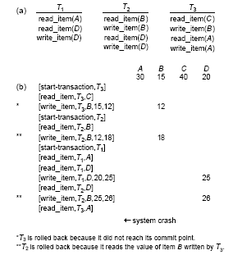

Slide 10
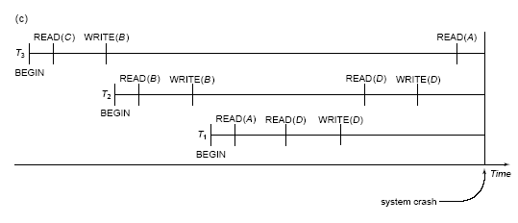

Slide 11
Recovery Techniques Based on Deferred Update
PROCEDURE RDU_M (WITH CHECKPOINTS): Use two lists of transactions maintained by the system: the committed transactions T since the last checkpoint (commit list), and the active transactions T (active list). REDO all the WRITE operations of the committed transactions from the log, in the order in which they were written into the log. The transactions that are active and did not commit are effectively canceled and must be resubmitted.

Slide 12
Recovery Techniques Based on Immediate Update
PROCEDURE RIU_M
Use two lists of transactions maintained by the system: the committed transactions since the last checkpoint and the active transactions.
Undo all the write_item operations of the active (uncommitted) transactions, using the UNDO procedure. The operations should be undone in the reverse of the order in which they were written into the log.
Redo all the write_item operations of the committed transactions from the log, in the order in which they were written into the log.

Slide 13
Shadow Paging
Directory
  Current directory
  Shadow directory
    During the transaction execution, shadow directory is never modified
Shadow page recovery
  Free the modified database pages
  Discard the current directory
Advantages
  No-redo/no-undo
Disadvantages
  Creating shadow directory may take a long time
  Updated database pages change locations
    Garbage collection is needed

Slide 14
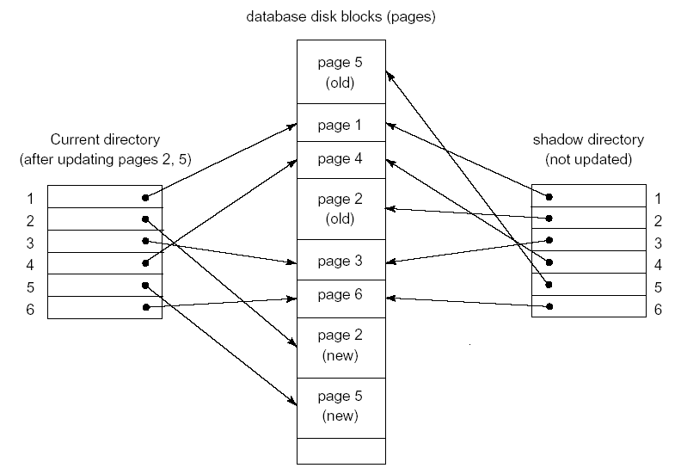
Shadow Paging

Slide 15
Recovery from Catastrophic Failures
Database backup
Log backup
Recovery strategy

Slide 16
Recovery in Multidatabase Systems
Multidatabase transaction
Global recovery manager or Coordinator
Two-phase commit protocol
  Phase 1
    At the end of the transaction, the coordinator sends a message to all participants “prepare to commit”
    Each participant, on receiving the message “force write all log entries on local disk” and sends OK signal to the coordinator
  Phase 2
    If all participants OK, the transaction is successful and the coordinator sends commit signal to all participants
    Otherwise transaction fails and the coordinator sends rollback signal to all participants

Slide 17
ARIES Recovery Algorithm
Steal/no-force approach for writing
  Write-Ahead Log (WAL)
  Repeating history during redo
  Logging changes during undo
Recovery procedure consists of three main steps
  Analysis --- identify the dirty (updated pages) in the buffer and set of active transactions at the time of failure
  Redo --- reapply updates from the log to the database. It will be done for the committed transactions.
  Undo --- scan the log backward and undo the actions of the active transactions in the reverse order.

Slide 18
ARIES Recovery Algorithm
Needed data structures
  Log sequence number (LSN) for every log record
  Transaction table
  Dirty page table
  Check pointing

Slide 19
Summary
Introduction
I/O model for databases revisited
Failure classification
Recovery concepts
Recovery techniques based on deferred update
Recovery techniques based on immediate update
Shadow paging
Recovery from catastrophic failures
The ARIES recovery algorithm
Thank you

